Slide 2
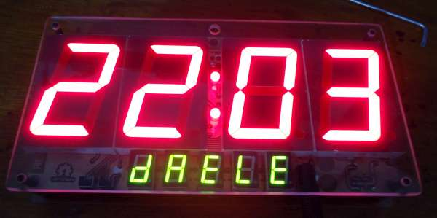
REAL 7 SEGMENT LED

Slide 3
7 SEGMENT LED
7 segment LED composed of 8 LEDs. Seven segments of a digit are arranged as a rectangle for symbol displayINTRODUCEing, whereas the additional segment is used for the purpose of displaying decimal point.
In order to simplify connection, anodes or cathodes of all diodes are connected to the common pin so that there are common anode displays and common cathode displays, respectively.
Segments are marked with the letters from a to g, plus dp, as shown in figure below. When connecting, each diode is treated separately, which means that each must have its own current limiting resistor.

Slide 4
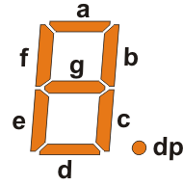
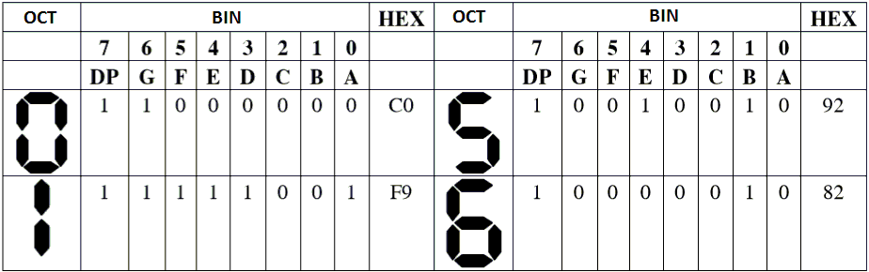
7 SEGMENTS LED

Slide 5
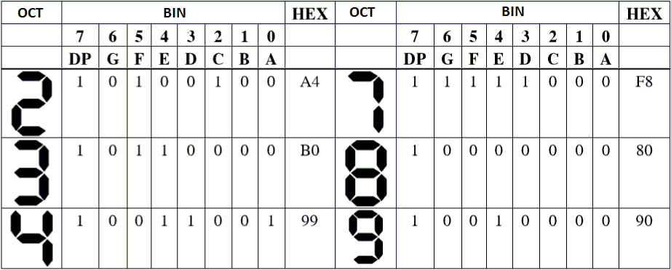
7 SEGMENTS LED

Slide 6
EXAMPLE
Control 2 anode common 7 segment leds connected with portb and portc to display the count result from 00 to 20

Slide 7
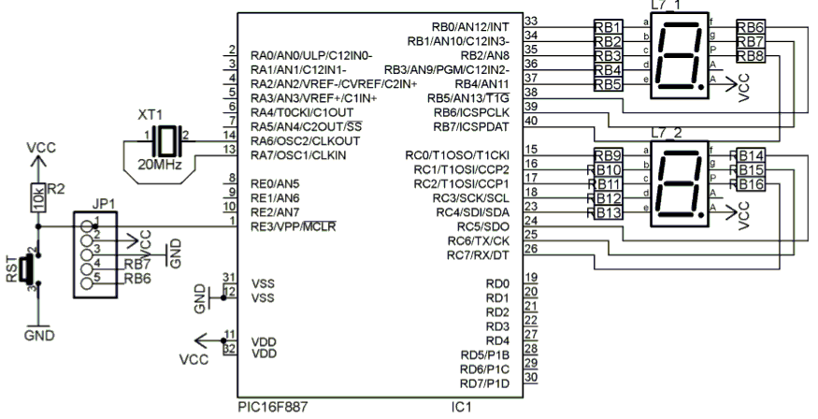
SCHEMATIC

Slide 8
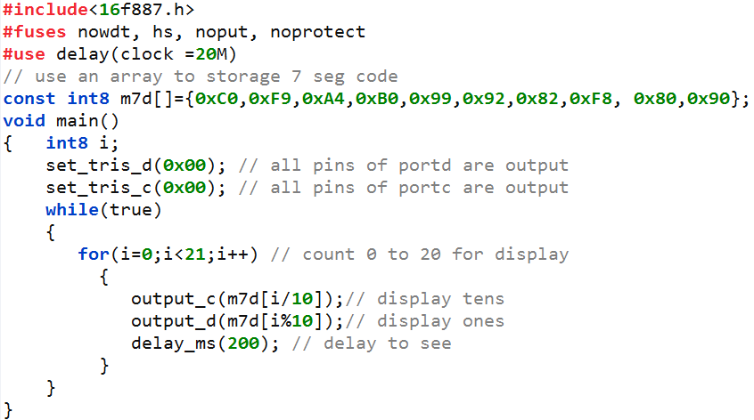
CODE

Slide 9
74HC595
As the previous example it costs 16 MCU pin to control 2 7 seg led.
PIC16F887 only has 35 I/O so it can’t control directly more than 4 led
One of the solution for this problem is using IC 74HC595 to extend I/O pin

Slide 10
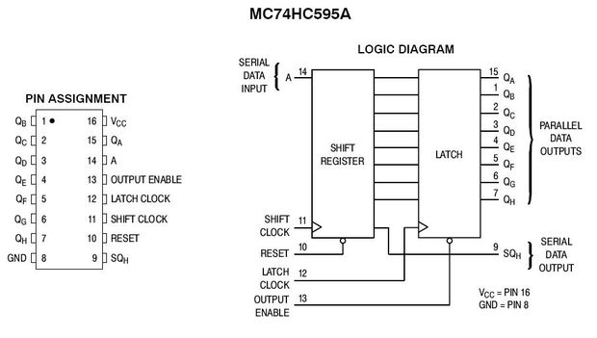
74HC595

Slide 11
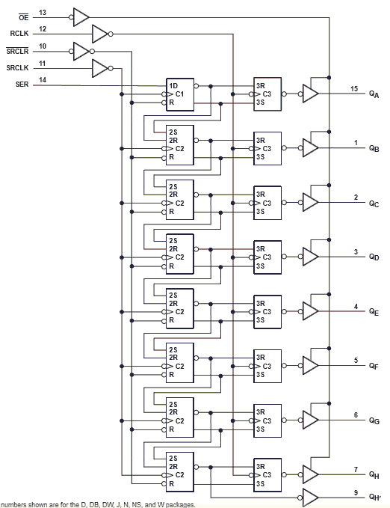
74HC595

Slide 12
EXAMPLE
Control 7 segment display the count result from 1234 to 1245 using ic 74HC595 to extend port.

Slide 13
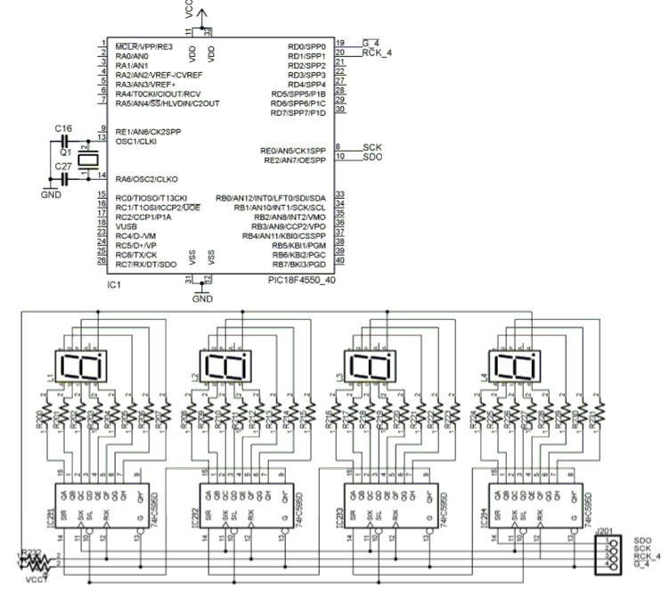

Slide 14
0 | 0 | 1 | 0 | 0 | 0 | 0 | 0
1 | 1 | x | 1 | 0 | 1 | 1 | x
x | 0 | x | 0 | 0 | 0 | 0 | 0

Slide 15
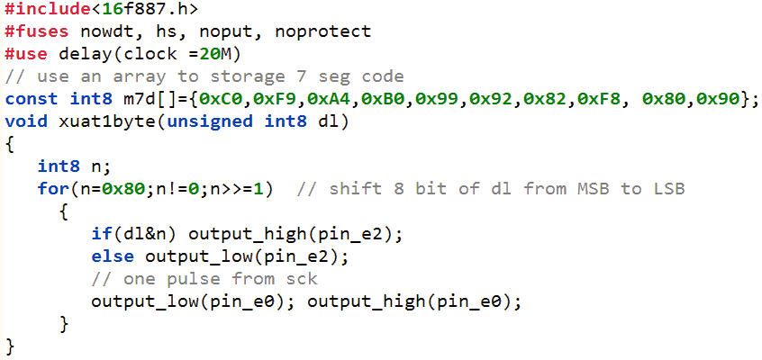
CODE

Slide 16
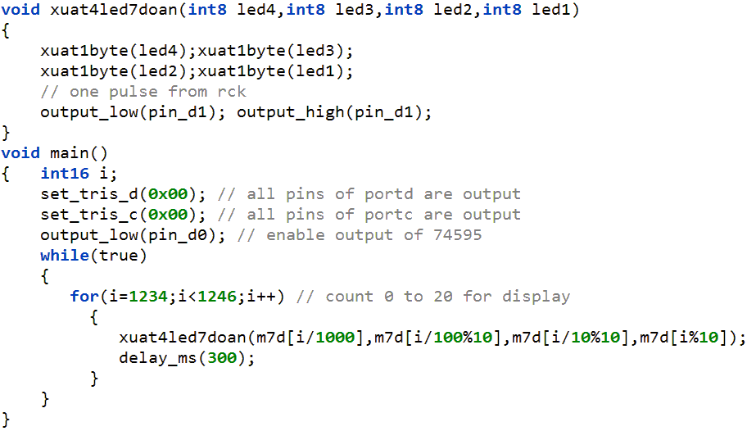
CODE

Slide 17
SCANNING METHOD
In the console unit, three 7 segment LEDs are used. These LEDs are controlled one by one in the order by PIC. In case of this method, because only 1 digit lights up at the same time, so, the electric power is cut down. The power unit becomes small too. This control is done at high speed, so, it seems to light up at the same time to the look.
PNP type transistor is used to control of LED. The 7 segment LED which was used this time is an anode common type.

Slide 18
SCANNING METHOD

Slide 19
STEPS TO SCAN LED
Output the code of digit to display
Select the led to display this digit( control transistor)
Delay to see( time delay belong to number of led used- for 8 led I choose 1 ms)
Turn off the led( control transistor)
5. Return to step one

Slide 20
EXAMPLE
Control 7 segment display the number 12345678 using scanning method

Slide 21
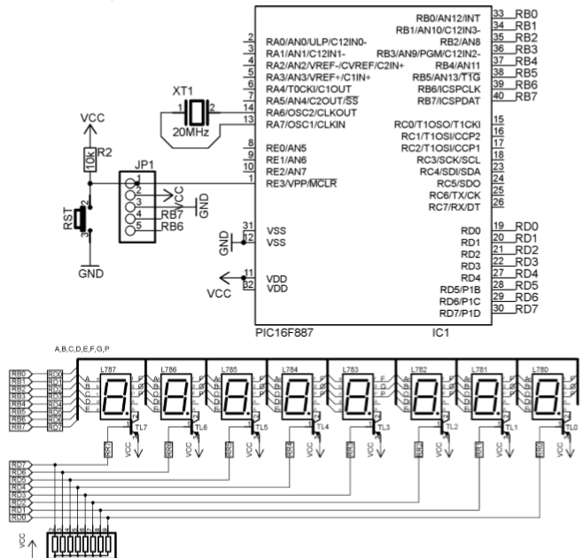
SCHEMATIC

Slide 22
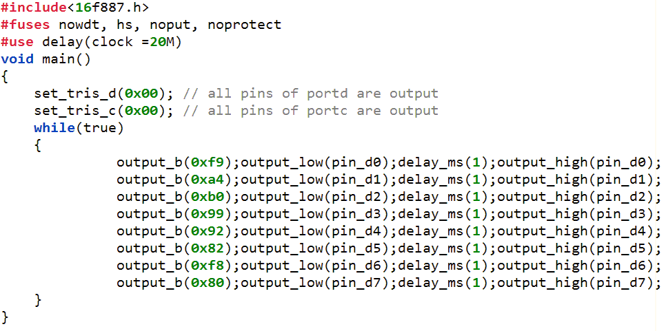
CODE

Slide 23
Test the theory by simulink

Slide 24
Thank You !

